Slide 1

Laboratory Research Project
Computer Science
Kenza Chaabouni
Supervised by Dr. Karima Makhlouf
An Empirical Analysis on the Effect of the Outcome Variable Binarization and Bias on Causal Discovery

Slide 2
Summary
Our study
Preliminaries
Causal structures
PC Algorithm
Experimental setting
The effect of the outcome variable binarization on Causal Discovery
Synthetic data
Real-world data
The Adult dataset
The Fragrances dataset
The effect of bias on Causal Discovery
Varying bias in the synthetic data
Amplifying bias in the Fragrances dataset
Conclusion

Slide 3
Our Study
The key contributions of this laboratory research project to Causal Discovery on Biased Data:
An empirical analysis of the outcome variable binarization on causal discovery
An empirical analysis of the effect of bias on causal discovery

Slide 4
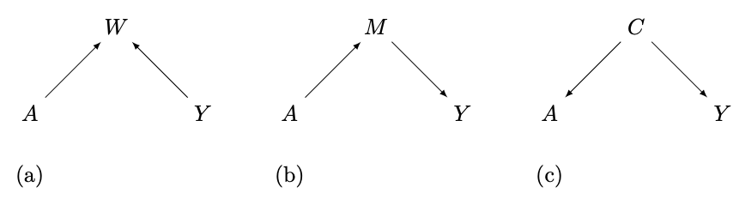
Preliminaries: Causal Structures
Collider

Slide 5
Preliminaries: Causal Structures
Collider
Mediator

Slide 6
Preliminaries: Causal Structures
Collider
Mediator
Confounder

Slide 7
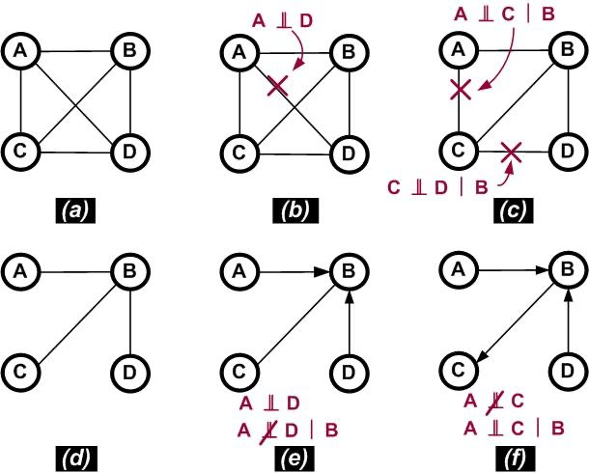
Preliminaries: PC Algorithm

Slide 8
Preliminaries: PC Algorithm
Conditional independence test

Slide 9
Preliminaries: PC Algorithm
Conditional independence test

Slide 10
Preliminaries: PC Algorithm
Conditional independence test

Slide 11
Preliminaries: PC Algorithm
Conditional independence test

Slide 12
Experimental setting
Dataset | Size | A | Dimension | Y
Synthetic | 1000 | A | 4 | Y
Adult | 49531 | gender | 8 | income
Fragrances | 539 | gender | 8 | price
Metadata of the datasets used in the experiments

Slide 13
The effect of the outcome variable binarization on Causal Discovery
Construct a baseline causal graph
Binarize the outcome variable Y using a range of thresholds
Examine the causal graphs obtained at each threshold
Quantify the relationship between the sensitive attribute A and the outcome Y using Statistical disparity:
SD = P(Y=1|A=1) - P(Y=1|A=0)

Slide 14
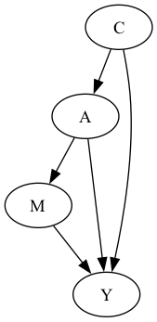
Synthetic data
Ground Truth Causal Graph for biased synthetic data

Slide 15
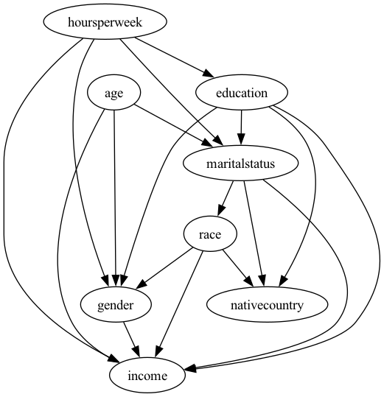
Real-world data: The Adult dataset
Baseline Causal Graph for Adult dataset

Slide 16
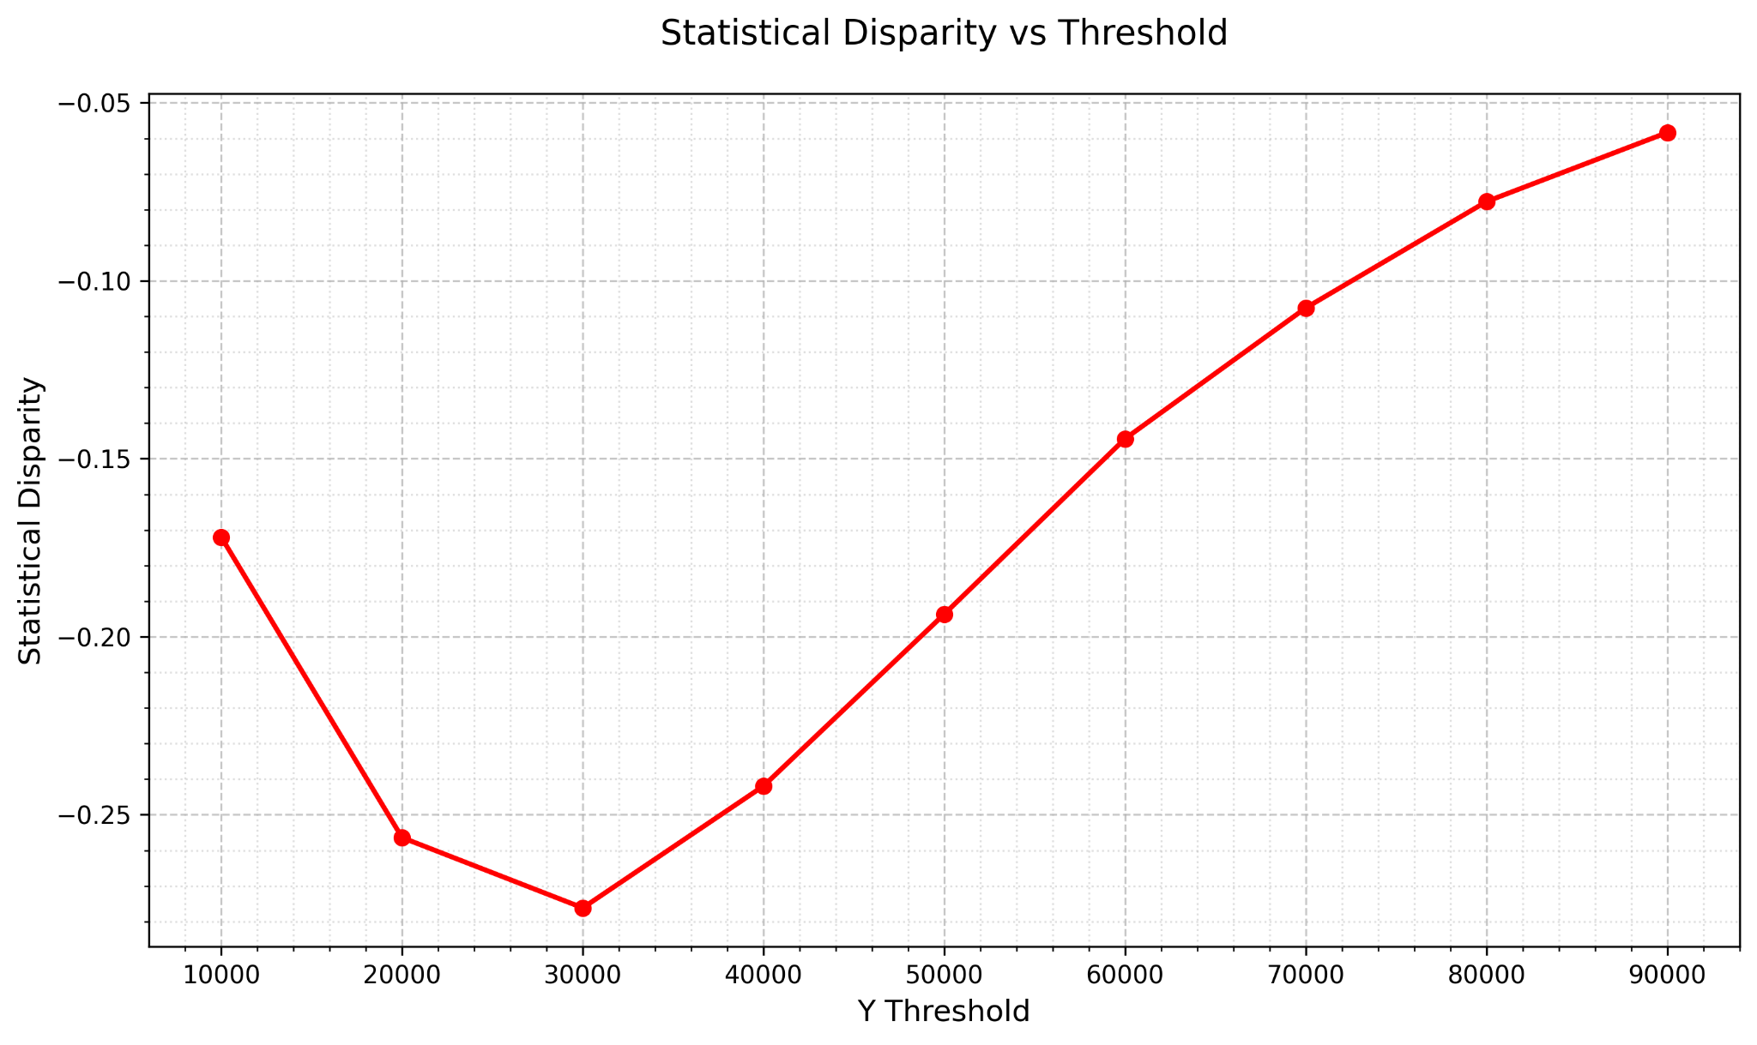
Real-world data: The Adult dataset
Statistical Disparity when varying the Threshold for the Adult Dataset

Slide 17
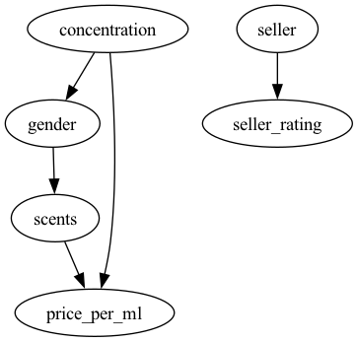
Real-world data: The Fragrances dataset
Baseline Causal Graph for Fragrances dataset

Slide 18
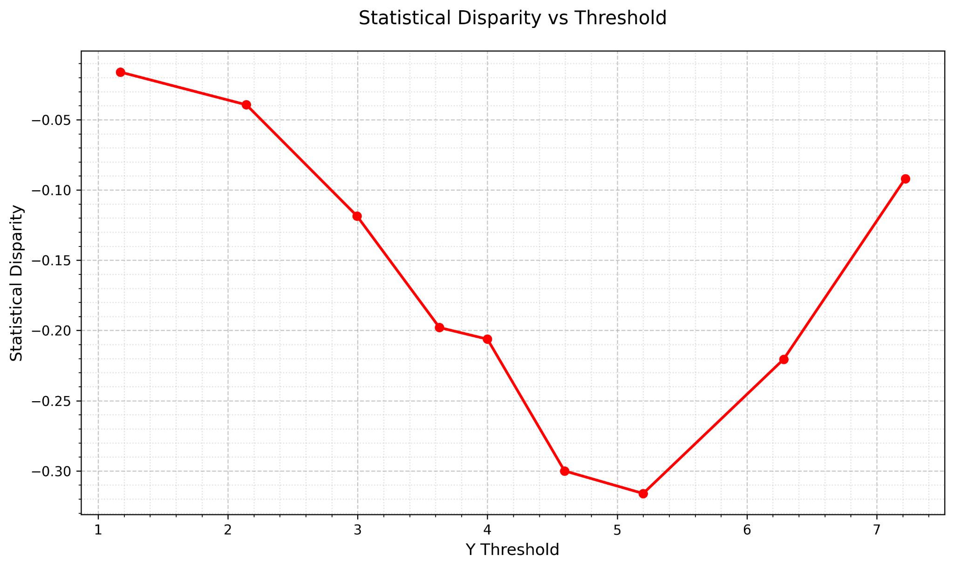
Real-world data: The Fragrances dataset
Statistical Disparity when varying the Threshold for the Fragrances Dataset

Slide 19
The effect of bias on Causal Discovery
Generate controlled synthetic data using with different bias levels
Amplify bias in the Fragrances dataset

Slide 20
Varying bias in the synthetic data
Ground Truth Causal Graph for synthetic data

Slide 21
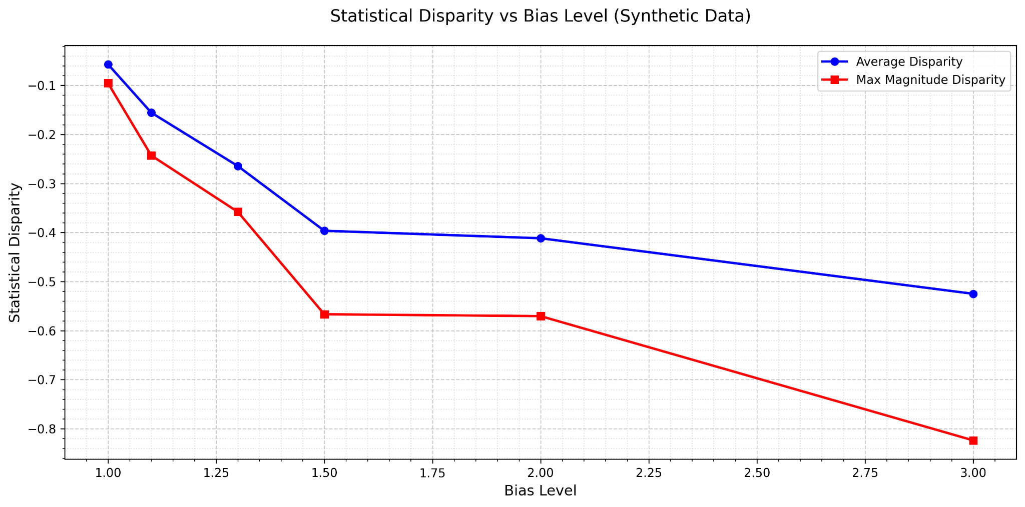
Varying bias in the synthetic data
Statistical disparity when varying the bias level for the synthetic datasets

Slide 22
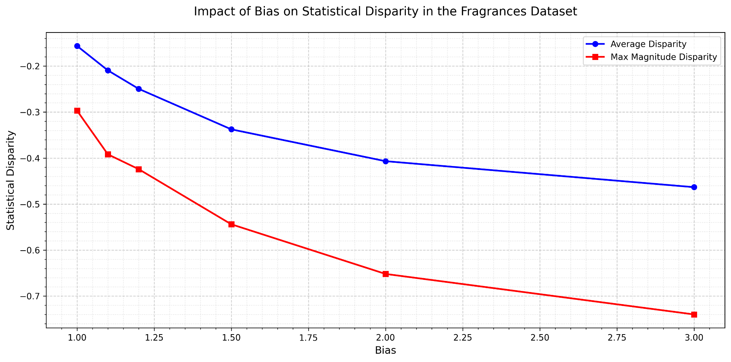
Amplifying bias in the Fragrances dataset
Statistical disparity when varying the bias level for the Fragrances dataset

Slide 23
Conclusion
Our findings highlight that:
The binarization of the outcome variable impacts the causal graph structure significantly, particularly the direct edge between the sensitive attribute A and the outcome Y.
In simpler dataset, with less causal structures surrounding the sensitive attribute and the outcome, statistical disparity aligns more closely with the appearance of direct causal edges.
Higher bias amplifies statistical disparity and the likelihood of discovering a direct causal edges between the sensitive attribute and the outcome. But with extreme biases, causal structures get distorted.

